Slide 1
Why cluster?
Labeling is expensive
Gain insight into the structure of the data
Find prototypes in the data
Notes:
Until now we have assumed that the training data is labeled.
Now we look at what can we do with data when we have not labels.
\item Example: group customer behavior, find similar buying patterns.

Slide 2
Goal of Clustering
Given a set of data points, each described by a set of attributes, find clusters such that:
  Inter-cluster similarity is
  maximized
  Intra-cluster similarity is
  minimized
Requires the definition of a similarity measure
F1
x
x
x
x
x
x
x
x
xx
x
x
x
x
x
x
xx
x
F2
Notes:
Data

Slide 3
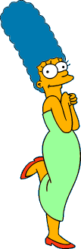



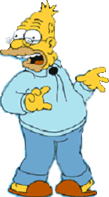
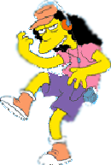
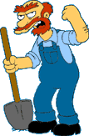

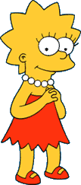
What is a natural grouping of these objects?
Slide from Eamonn Keogh

Slide 4



What is a natural grouping of these objects?
Slide from Eamonn Keogh
Clustering is subjective
Simpson's Family
School Employees
Females
Males

Slide 5
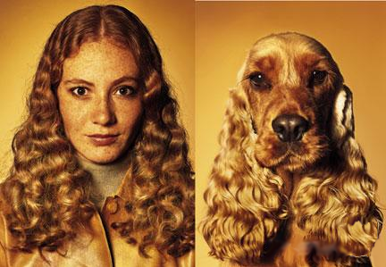
What is Similarity?
Slide based on one by Eamonn Keogh
Similarity is hard to define, but…
“We know it when we see it”

Slide 6
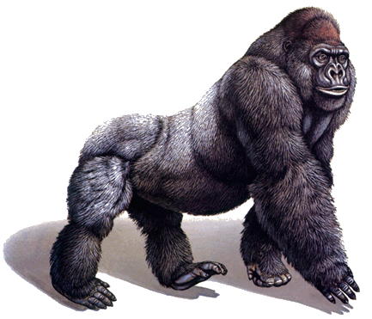
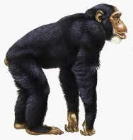
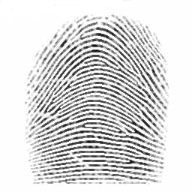
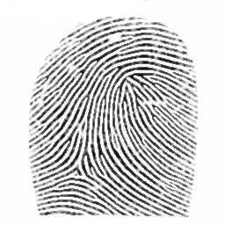
Defining Distance Measures
Slide from Eamonn Keogh
Definition: Let O₁ and O₂ be two objects from the universe of possible objects. The distance (dissimilarity) between O₁ and O₂ is a real number denoted by D(O₁,O₂)
Peter
Piotr
0.23
3
342.7

Slide 7
Slide based on one by Eamonn Keogh
What properties should a distance measure have?
D(A,B) = D(B,A) Symmetry
D(A,A) = 0 Constancy of Self-Similarity
D(A,B) = 0 iif A= B Positivity (Separation)
D(A,B) ≤ D(A,C) + D(B,C) Triangular Inequality

Slide 8
Slide based on one by Eamonn Keogh
Intuitions behind desirable distance measure properties
D(A,B) = D(B,A)
Otherwise you could claim “Alex looks like Bob, but Bob looks nothing like Alex.”
D(A,A) = 0
Otherwise you could claim “Alex looks more like Bob, than Bob does.”

Slide 9
Slide based on one by Eamonn Keogh
Intuitions behind desirable distance measure properties (continued)
D(A,B) = 0 IIf A=B
Otherwise there are objects in your world that are different, but you cannot tell apart.
D(A,B) ≤ D(A,C) + D(B,C)
Otherwise you could claim “Alex is very like Bob, and Alex is very like Carl, but Bob is very unlike Carl.”

Slide 10


Two Types of Clustering
Slide based on one by Eamonn Keogh
Partitional algorithms: Construct various partitions and then evaluate them by some criterion
Hierarchical algorithms: Create a hierarchical decomposition of the set of objects using some criterion
Hierarchical
Partitional
Notes:
Have class break into groups and invent clustering algorithms.

Slide 11
Dendogram: A Useful Tool for Summarizing Similarity Measurements
Slide based on one by Eamonn Keogh
The similarity between two objects in a dendrogram is represented as the height of the lowest internal node they share.

Slide 12
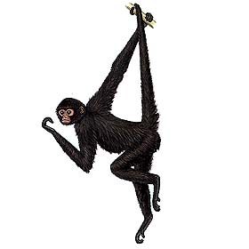
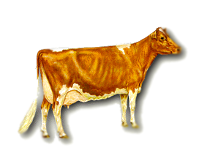
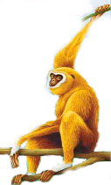
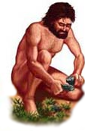
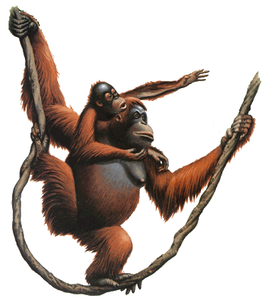
Slide based on one by Eamonn Keogh
There is only one dataset that can be perfectly clustered using a hierarchy…
(Bovine:0.69395, (Spider Monkey 0.390, (Gibbon:0.36079,(Orang:0.33636,(Gorilla:0.17147,(Chimp:0.19268, Human:0.11927):0.08386):0.06124):0.15057):0.54939);

Slide 13
A demonstration of hierarchical clustering using string edit distance
Slide based on one by Eamonn Keogh
Piotr
Pedro
Piero
Peter
Peka
Mick
Pyotr
Pietro
Pierre
Peder
Petros
Peadar
Miguel
Krystof
Michael
Michalis
Crisdean
Cristovao
Christoph
Cristobal
Kristoffer
Christophe
Cristoforo
Christopher

Slide 14











Slide based on one by Eamonn Keogh
Hierarchal clustering can sometimes show patterns that are meaningless or spurious
The tight grouping of Australia, Anguilla, St. Helena etc is meaningful; all these countries are former UK colonies
However the tight grouping of Niger and India is completely spurious; there is no connection between the two.
South Georgia &
South Sandwich
Islands
Serbia &
Montenegro
(Yugoslavia)
AUSTRALIA
St. Helena &
Dependencies
ANGUILLA
U.K.
FRANCE
NIGER
INDIA
IRELAND
BRAZIL

Slide 15
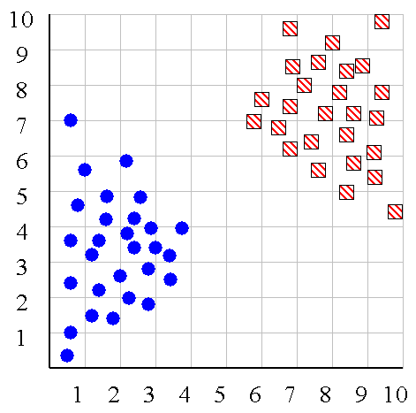
Slide based on one by Eamonn Keogh
We can look at the dendrogram to determine the “correct” number of clusters.
Notes:
In this case, the two highly separated subtrees are highly suggestive of two clusters. (Things are rarely this clear cut, unfortunately)

Slide 16
Slide based on one by Eamonn Keogh
One potential use of a dendrogram: detecting outliers
The single isolated branch is suggestive of a data point that is very different to all others
Outlier

Slide 17
Hierarchical Clustering
Slide based on one by Eamonn Keogh
The number of dendrograms with n leafs = (2n -3)!/[(2^{(n -2)}) (n -2)!]
Number Number of Possible
of Leafs Dendrograms
2 1
3 3
4 15
5 105
... …
34,459,425
Since we cannot test all possible trees we will have to heuristic search of all possible trees. We could do this..
Bottom-Up (agglomerative): Starting with each item in its own cluster, find the best pair to merge into a new cluster. Repeat until all clusters are fused together.
Top-Down (divisive): Starting with all the data in a single cluster, consider every possible way to divide the cluster into two. Choose the best division and recursively operate on both sides.

Slide 18


Slide based on one by Eamonn Keogh
We begin with a distance matrix which contains the distances between every pair of objects in our database.
0
8
8
7
7
0
2
4
4
D( , ) = 8
D( , ) = 1
0
3
3
0
1
0

Slide 19
Bottom-Up (agglomerative): Starting with each item in its own cluster, find the best pair to merge into a new cluster. Repeat until all clusters are fused together.
This slide and next 4 based on slides by Eamonn Keogh
Consider all possible merges…
Choose the best
…

Slide 20
Bottom-Up (agglomerative): Starting with each item in its own cluster, find the best pair to merge into a new cluster. Repeat until all clusters are fused together.
Consider all possible merges…
Choose the best
…
Consider all possible merges…
Choose the best
…

Slide 21
Bottom-Up (agglomerative): Starting with each item in its own cluster, find the best pair to merge into a new cluster. Repeat until all clusters are fused together.
Consider all possible merges…
Choose the best
…
Consider all possible merges…
Choose the best
…
Consider all possible merges…
Choose the best
…

Slide 22
Bottom-Up (agglomerative): Starting with each item in its own cluster, find the best pair to merge into a new cluster. Repeat until all clusters are fused together.
Consider all possible merges…
Choose the best
…
Consider all possible merges…
Choose the best
…
Consider all possible merges…
Choose the best
…

Slide 23
Slide based on one by Eamonn Keogh
We know how to measure the distance between two objects, but defining the distance between an object and a cluster, or defining the distance between two clusters is non obvious.
Single linkage (nearest neighbor): In this method the distance between two clusters is determined by the distance of the two closest objects (nearest neighbors) in the different clusters.
Complete linkage (furthest neighbor): In this method, the distances between clusters are determined by the greatest distance between any two objects in the different clusters (i.e., by the "furthest neighbors").
Group average linkage: In this method, the distance between two clusters is calculated as the average distance between all pairs of objects in the two different clusters.

Slide 24
Slide based on one by Eamonn Keogh
Single linkage
Average linkage

Slide 25
Slide based on one by Eamonn Keogh
Hierarchal Clustering Methods Summary
No need to specify the number of clusters in advance
Hierarchal nature maps nicely onto human intuition for some domains
They do not scale well: time complexity of at least O(n²), where n is the number of total objects
Like any heuristic search algorithms, local optima are a problem
Interpretation of results is (very) subjective

